Slide 1
Lightning Talk 1
Product Research
sdmay25-24

Slide 2
Project Overview
Background:
The IINSPIRE Survey gauges the research experience of undergraduates in STEM.
It is a survey visualization tool in the form of a web application.
Problem Statement:
The goal of this project is to redesign, upgrade, and test the previous web application for visualizing survey data from STEM undergraduates.
Our Solution:
Automate the visualization process through the previous web application to streamline the data from the survey results.

Slide 3
Google Forms
Core Features:
Free access to search results, citation tracking, and Google integration
Familiar search interface used exactly like Google
Advantages:
Easy to use and access, large reach of users
Familiar and fast results
Disadvantages:
Restricting template, broad coverage, limited targeting options
Paywalls (e.g., Google Classroom)

Slide 4
Survey Monkey
Core Features:
Intuitive UI, user-friendly analytics tools, and real-time results
Customizable surveys with mobile optimization
Advantages:
Easy to use for non-technical users, wide app integrations
Low barrier to entry, real-time results, and customization options
Disadvantages:
Limited features in the free plan, some institutions block SurveyMonkey emails
Requires internet, lacks advanced survey customization compared to competitors

Slide 5
Qualtrics
Core Strengths:
Powerful data visualization, smart analytics, and AI insights
Tailored for enterprise use
Advantages:
Advanced data visualization, real-time survey creation
Import past survey data, integration of AI for trend analysis
Disadvantages:
Expensive, steep learning curve for new users
Admin tools not as advanced compared to competitors

Slide 6
Market Gap
Advanced Analytics:
Use an advanced tool to detect trends, correlations, or predictive analytics
Enhanced Security and Privacy:
Surveys that allow users to submit anonymous answers while maintaining the integrity of the data
Niche Audience Access:
Create a professional platform that professors and students will enjoy taking

Slide 7
New Ideas
Simplified UI:
Focus on offering all required functionality without overwhelming the User Interface. Need to provide powerful analytics while maintaining a high usability.
Real Time Report Generation:
Added functionality of generating reports in real time after survey completion. Allows admins and users to review results instantly after user finishes survey.
Advanced Security Features:
Add Multi-Factor Authentication and password recovery functionality

Slide 8
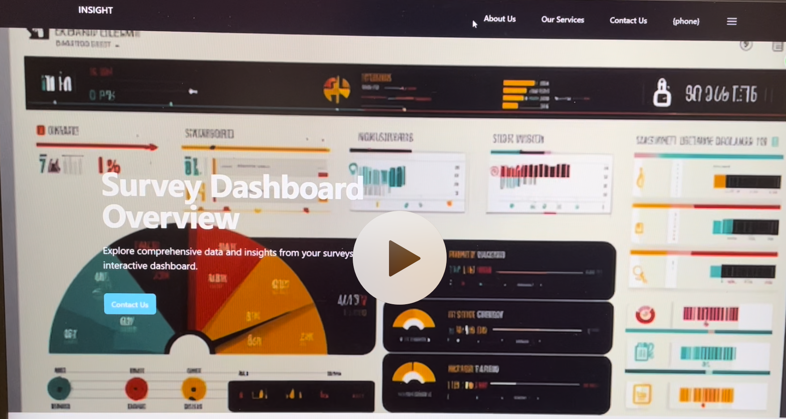
Design Prototype
Initial design concept and color mapping

Slide 9
Conclusion
Enhanced User Experience:
New Survey will improve the appearance of the old survey and have a more intuitive UI
Comparison:
This project aims to provide a free solution to powerful data visualization.

