Slide 1
User Needs and Requirements
Lightning Talk 3:
sdmay25-24

Slide 2
Project Overview
Background:
The INSPIRE Survey gauges the research experience of undergraduates in STEM.
It is a survey visualization tool in the form of a web application.
Problem Statement:
The goal of this project is to redesign, upgrade, and test the previous web application for visualizing survey data from STEM undergraduates.
Our Solution:
Automate the visualization process through the previous web application to streamline the data from the survey results.

Slide 3
User Role Overview
Our project features 4 distinct user roles:
INSIGHT Admin
Researchers
INSIGHT Staff
Participants
INSIGHT Admin
Tier 1
Researchers
INSIGHT Staff
Tier 2
Participants
Tier 3
Note: Privileges increase as tiers go up

Slide 4
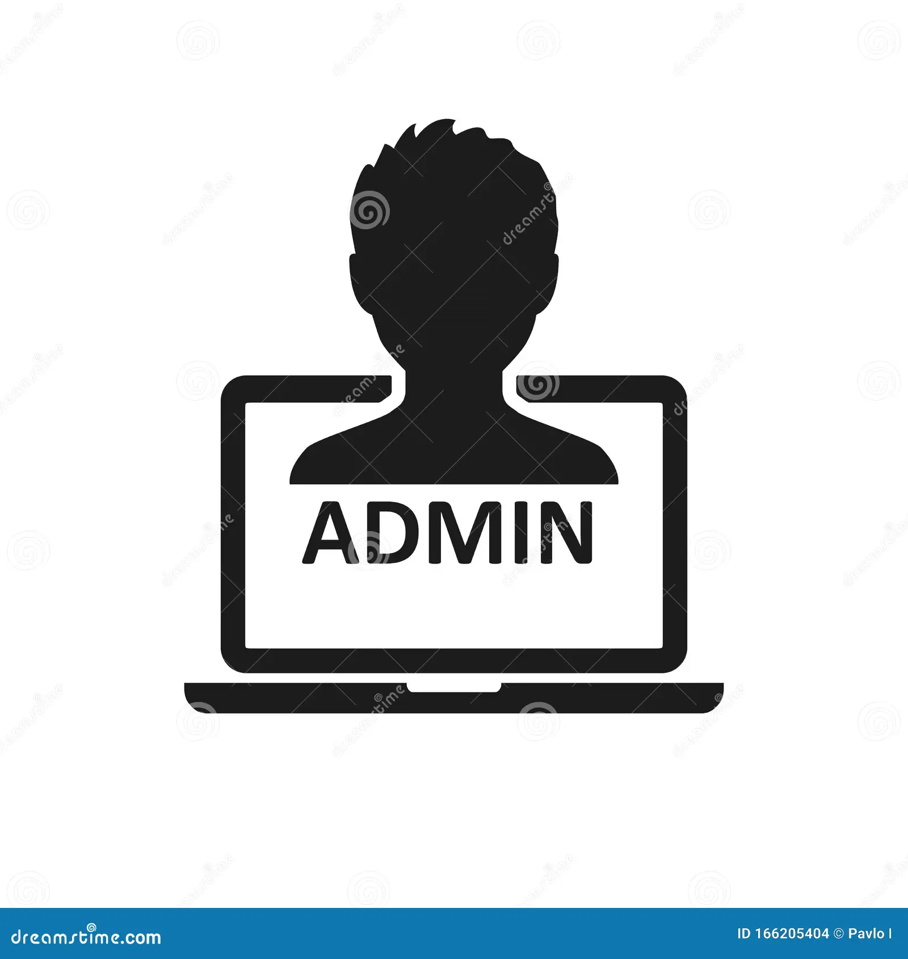
User Role Description: INSIGHT Admin
INSIGHT Admin (Tier 1):
Create, edit, remove surveys
Add, remove, edit all other user roles (Researchers, INSIGHT Staff, Participants)
Invite new users (all tiers)
Allow access to data download
View survey results and visualizations

Slide 5
User Role Overview: Researcher (Tier 2)
Researcher (Tier 2a):
Export data to CSV file
Sort user data based on demographic
Search user results based on user email
View holistic survey results and visualizations

Slide 6
User Role Overview: INSIGHT Staff (Tier 2)
INSIGHT Staff (Tier 2b):
Create, edit, delete surveys
Assign surveys to
Store/view survey results
Share data
Download data
View survey results and visualizations

Slide 7
User Role Overview: Participants (Tier 3)
Participants (Tier 3):
Sign In/Out
Take assigned surveys
View personal survey results

Slide 8
Requirements
Tier 1:
Access to all users and participants.
Ability to set and enforce survey creation standards.
Overview of all surveys and their status.
Tier 2:
Ability to view and analyze survey metrics.
Ensure participant anonymity in all data collected.
Access to customizable reports for research purposes.
Tier 3:
Simple registration and login process.
Easy access to surveys with a web-friendly interface.
Engaging surveys that are easy to understand yet thought-provoking.

Slide 9
Engineering Standards
ISO/IEC 25010: Software quality model that defines characteristics like usability, reliability, and performance.
ISO/IEC 27001: Information security management standards to protect user data and ensure confidentiality
ISO/IEC 9126: Software product quality standards, ensuring the app meets functional and non-functional requirements.
IEEE 730: Standards for software quality assurance processes.

