Slide 1
Project Planning
sdmay25-14
Lightning Talk 4

Slide 2
Project Overview
Background:
The INSPIRE Survey gauges the research experience of undergraduates in STEM.
It is a survey visualization tool in the form of a web application.
Problem Statement:
The goal of this project is to redesign, upgrade, and test the previous web application for visualizing survey data from STEM undergraduates.
Our Solution:
Automate the visualization process through the previous web application to streamline the data from the survey results.

Slide 3
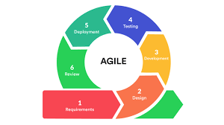
Project Management
Allows us to respond to changes in requirements, customer feedback, or market conditions.
Agile Workflow

Slide 4
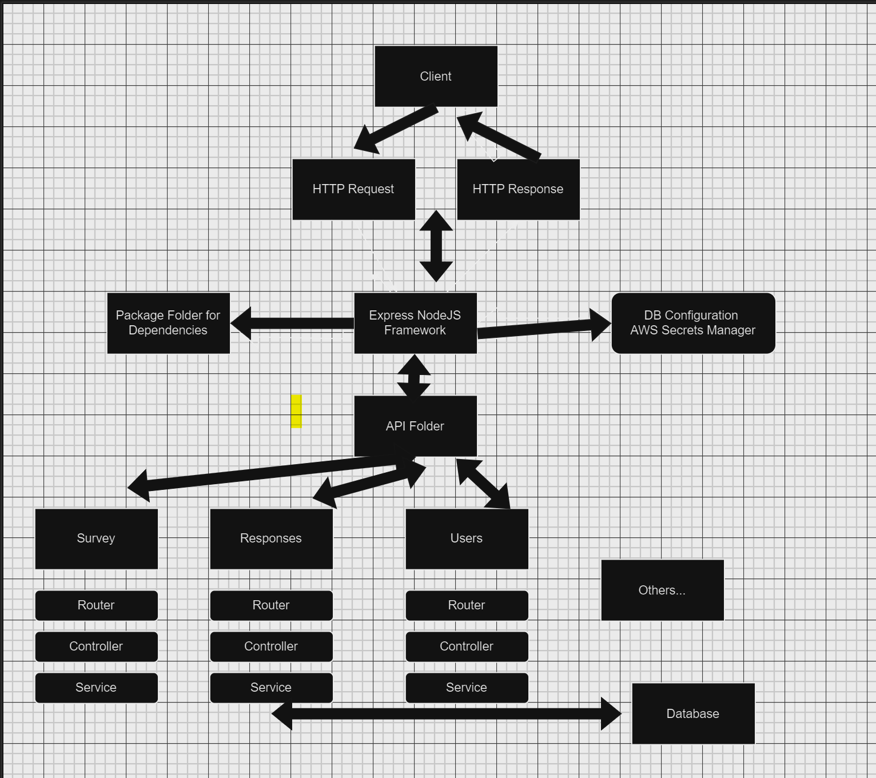
Task Decomposition
-Get old app working
-Full UI redesign
-Additional features like previous button and editable survey questions
Major tasks according to advisor

Slide 5
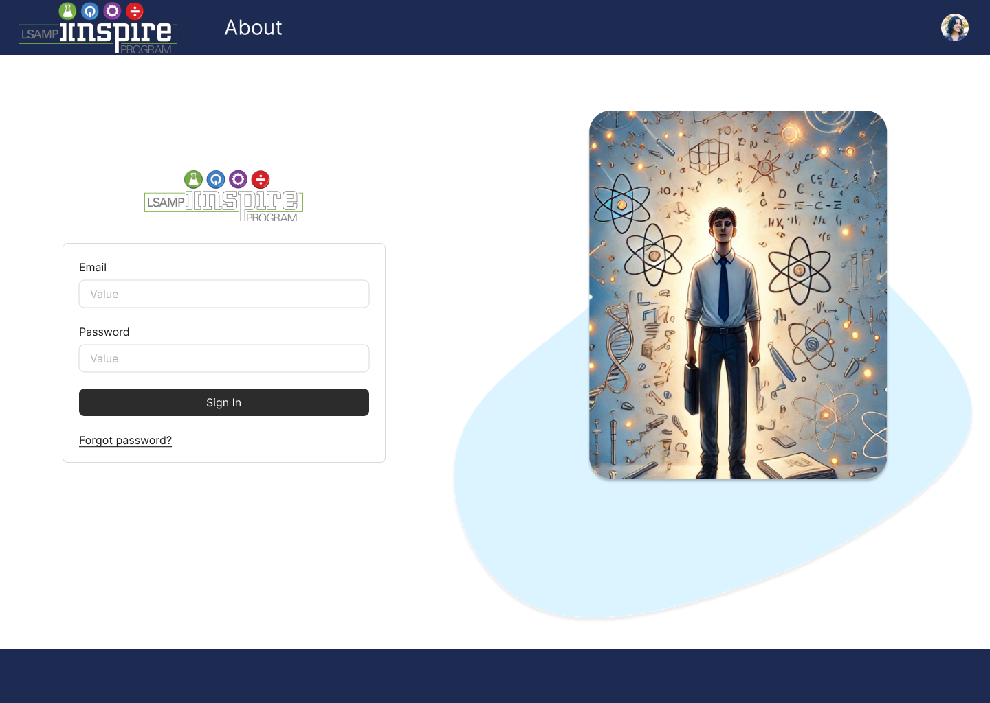
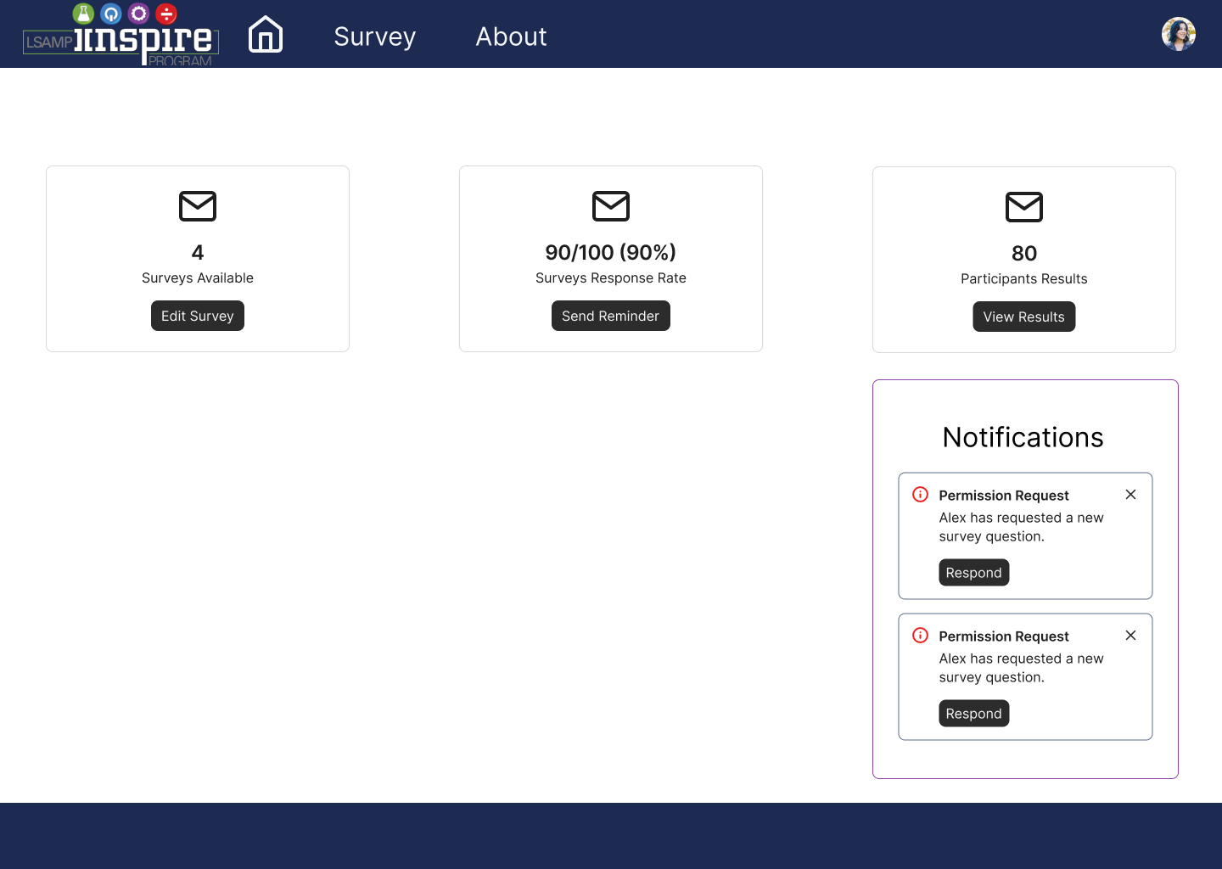
Key Metrics and Milestones
Full UI redesign that is more appealing for users
Modular survey system

Slide 6
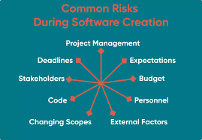
Key Risks and Risk Strategies
Getting previous groups code running with new AWS server.
Redesign UI/backend while also maintaining a working project

