Slide 1
IINSPIRE LSAMP Detailed Design
Team: SDMay25-24
Client: LSAMP
Advisor: Dr. Rover
Notes:
Nick: Hey everyone, my name is Nick and we are team 24. Our project is the IINSPIRE LSAMP web application.
Alex: Our project revolves around the IINSPIRE LSAMP Program. The LSAMP program focuses on expanding the participation of underrepresented groups in STEM education. (LSAMP) – Louis Stokes Alliance for Minority Participation

Slide 2
Project Overview
Our project focuses on surveys sent to students participating in the IINSPIRE LSAMP program at Iowa, Iowa State, and other universities
Notes:
Alex: Our project focuses on surveys sent to the students participating in this program. Program Admins can view collective survey results and individual students can view personal results and compare them over time. This project continues work done by a previous team, intending to help program coordinators improve the program at their respective Universities.

Slide 3
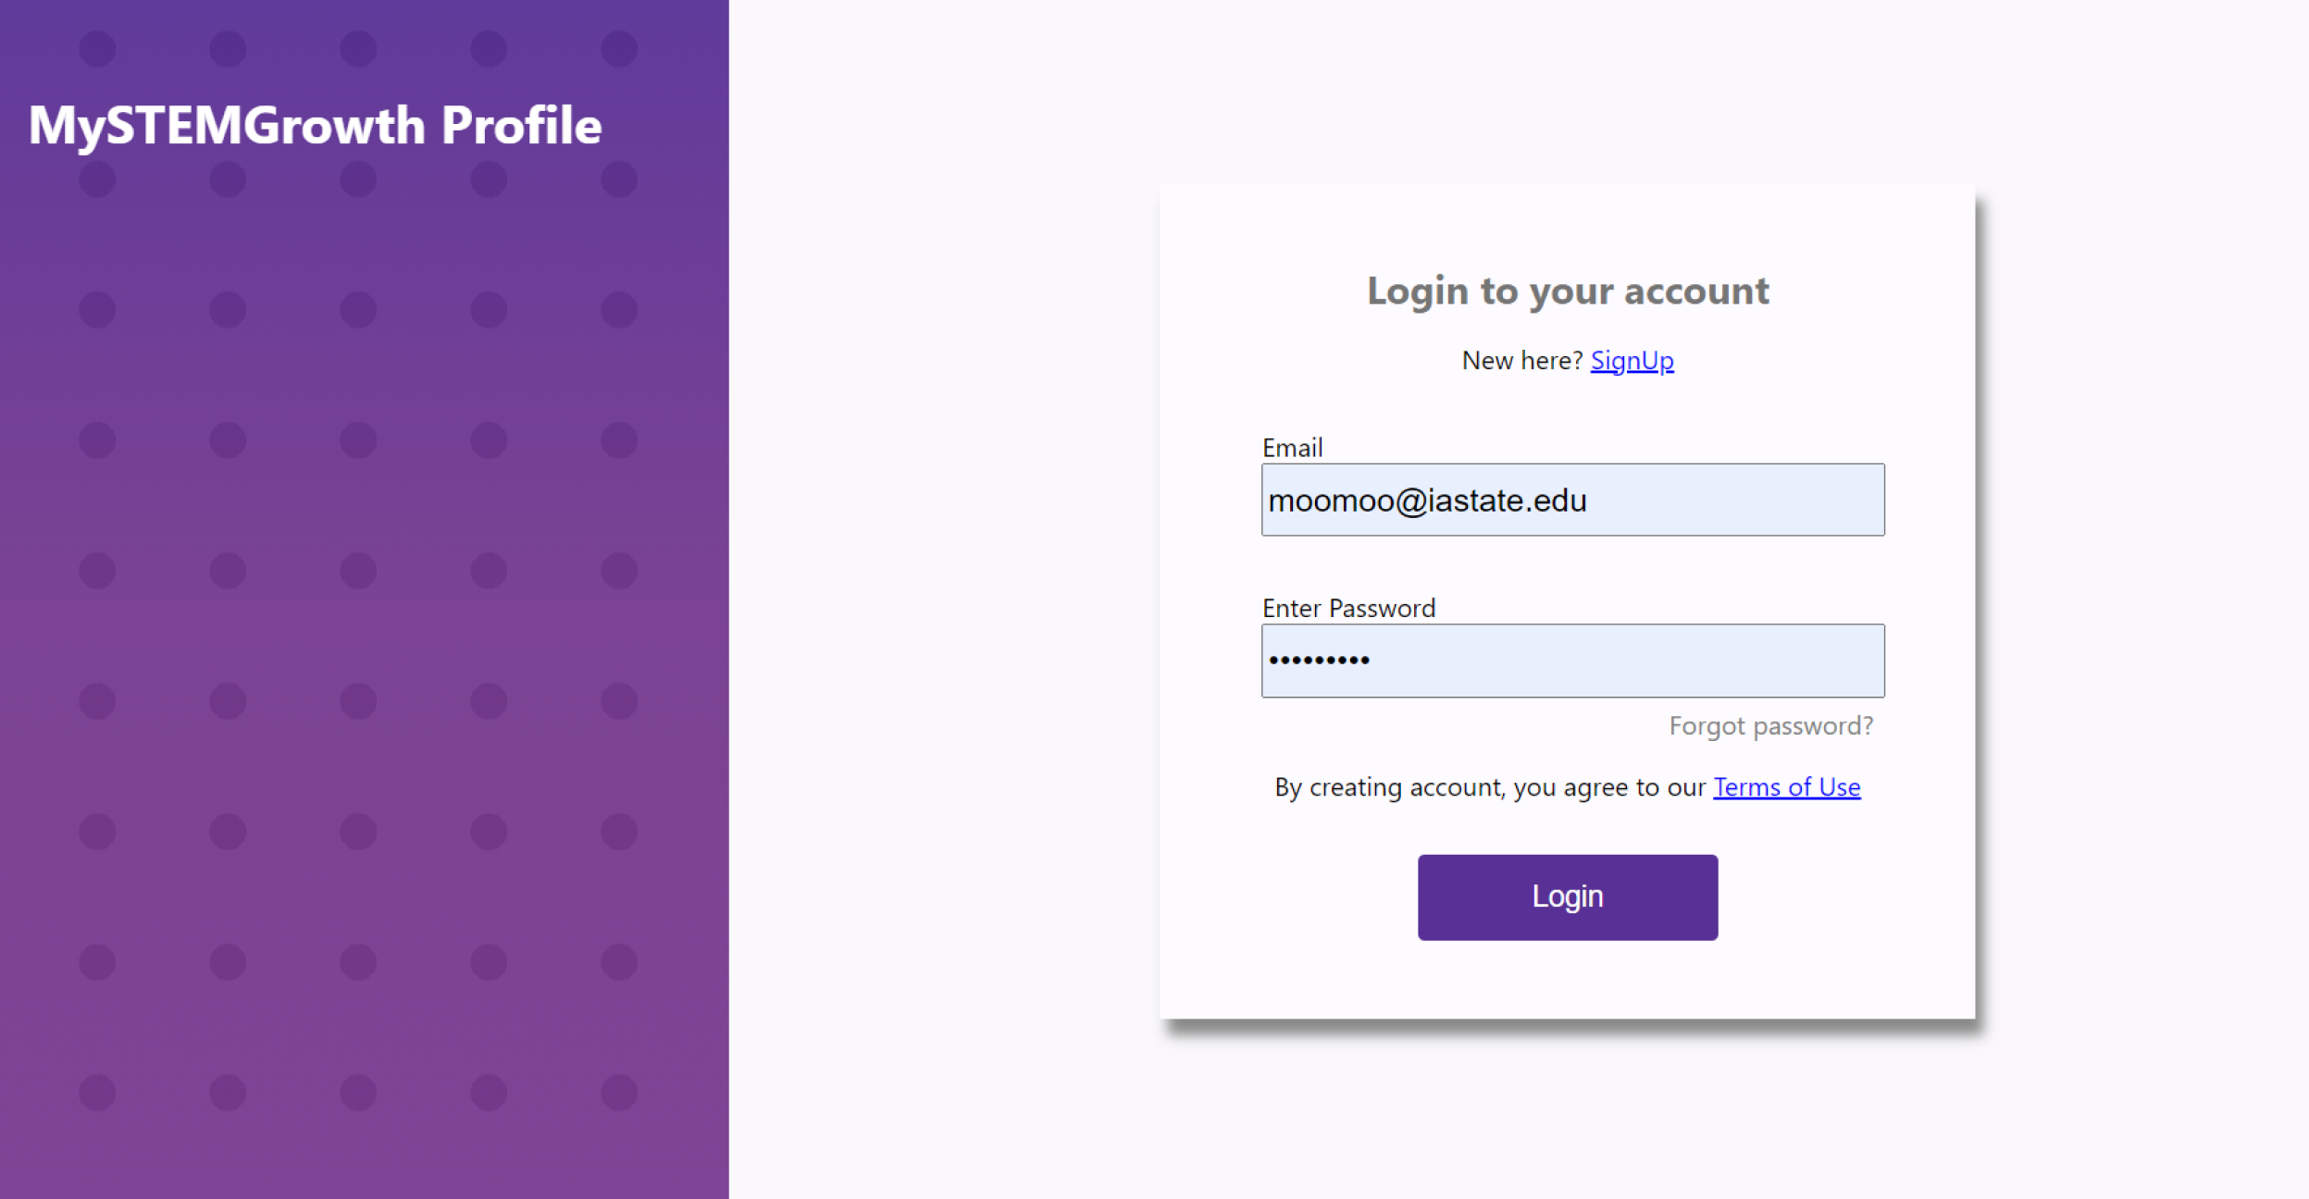
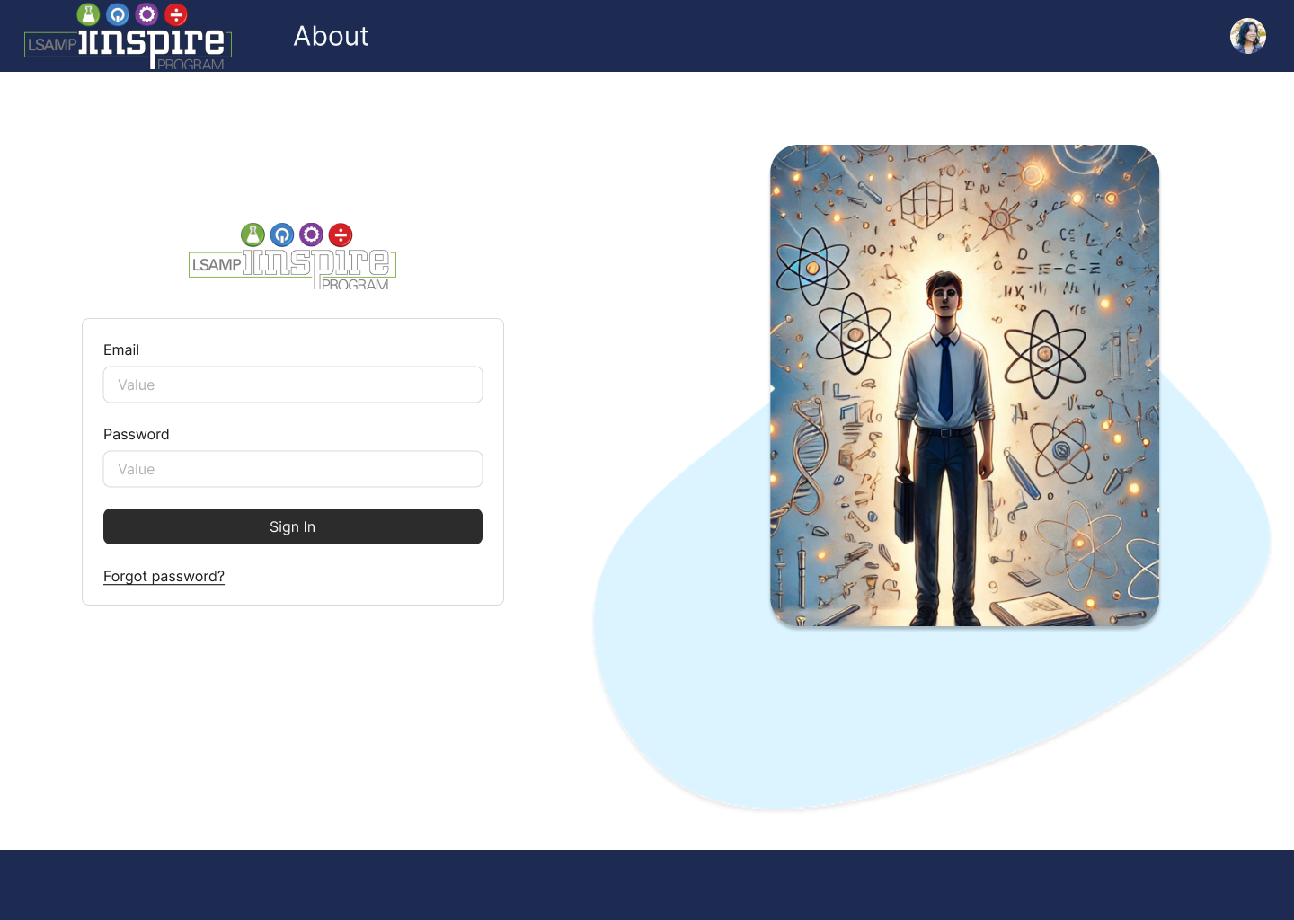
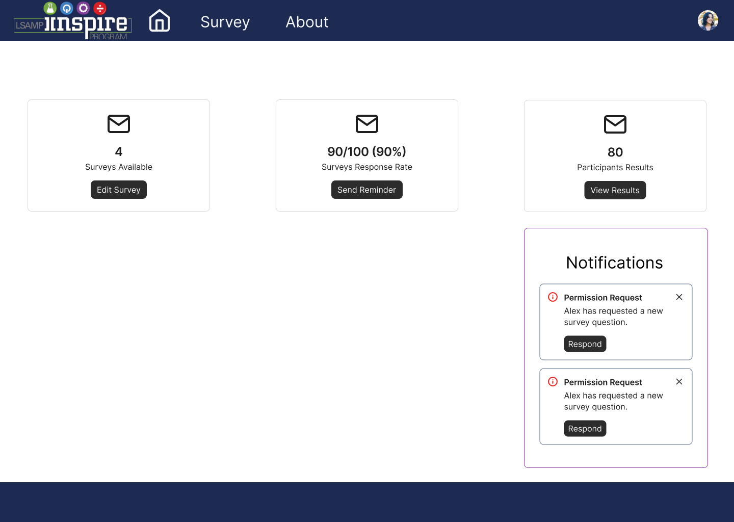
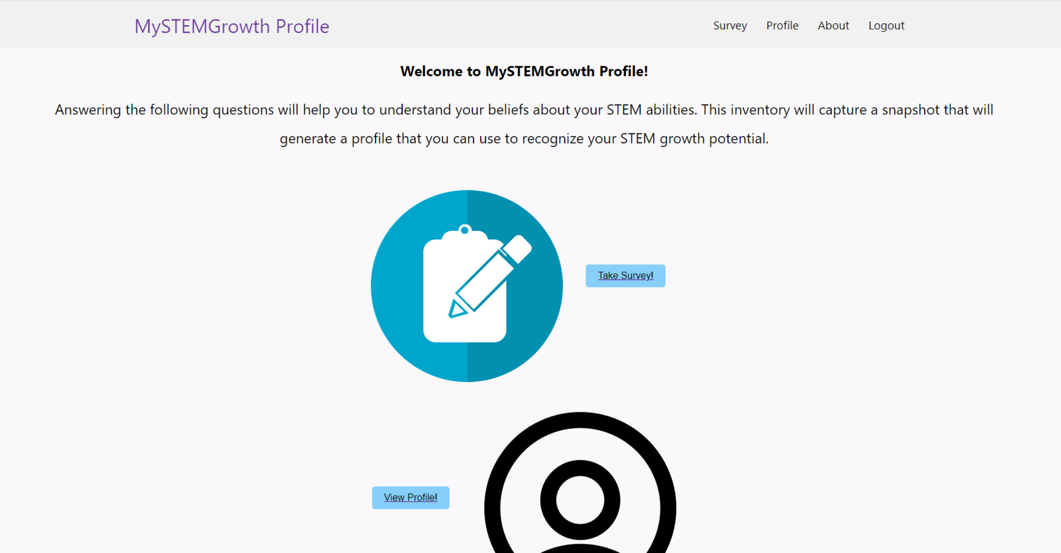
Detailed Design and Visuals
Notes:
Max
Because we this is a continuation from last years project we have a pretty good starting point for our design
Old system used react with raw css (point out the ugly old dashboard)
We are going to be updating with react and Chakra UI component library
The dashboard on the bottom right is going to change and display different information based on the type of user

Slide 4
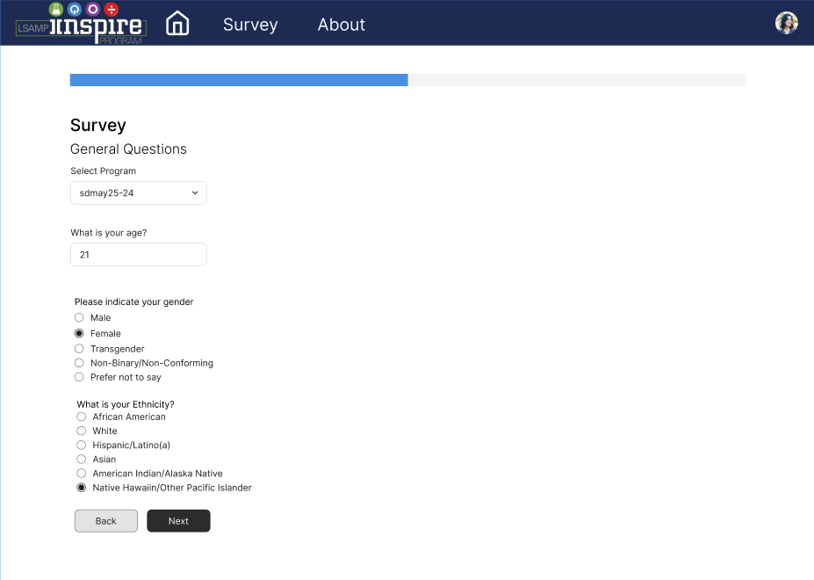
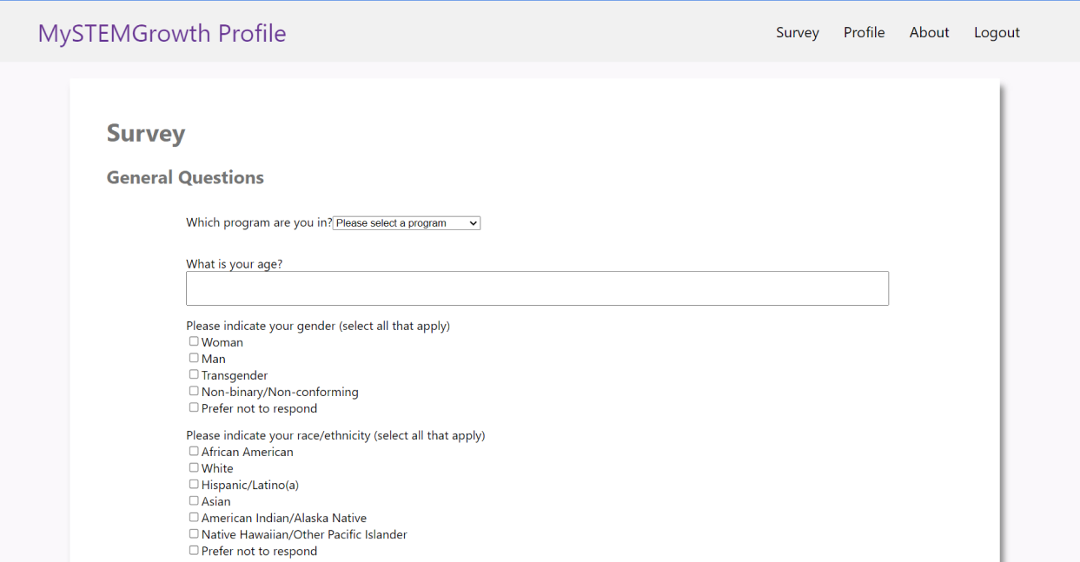
Detailed Design and Visuals
Notes:
Max
The survey redesign itself is one of the things we focused on the most
Adding betting inputs (number, multiple choice, multi-select)
Progress bar

Slide 5
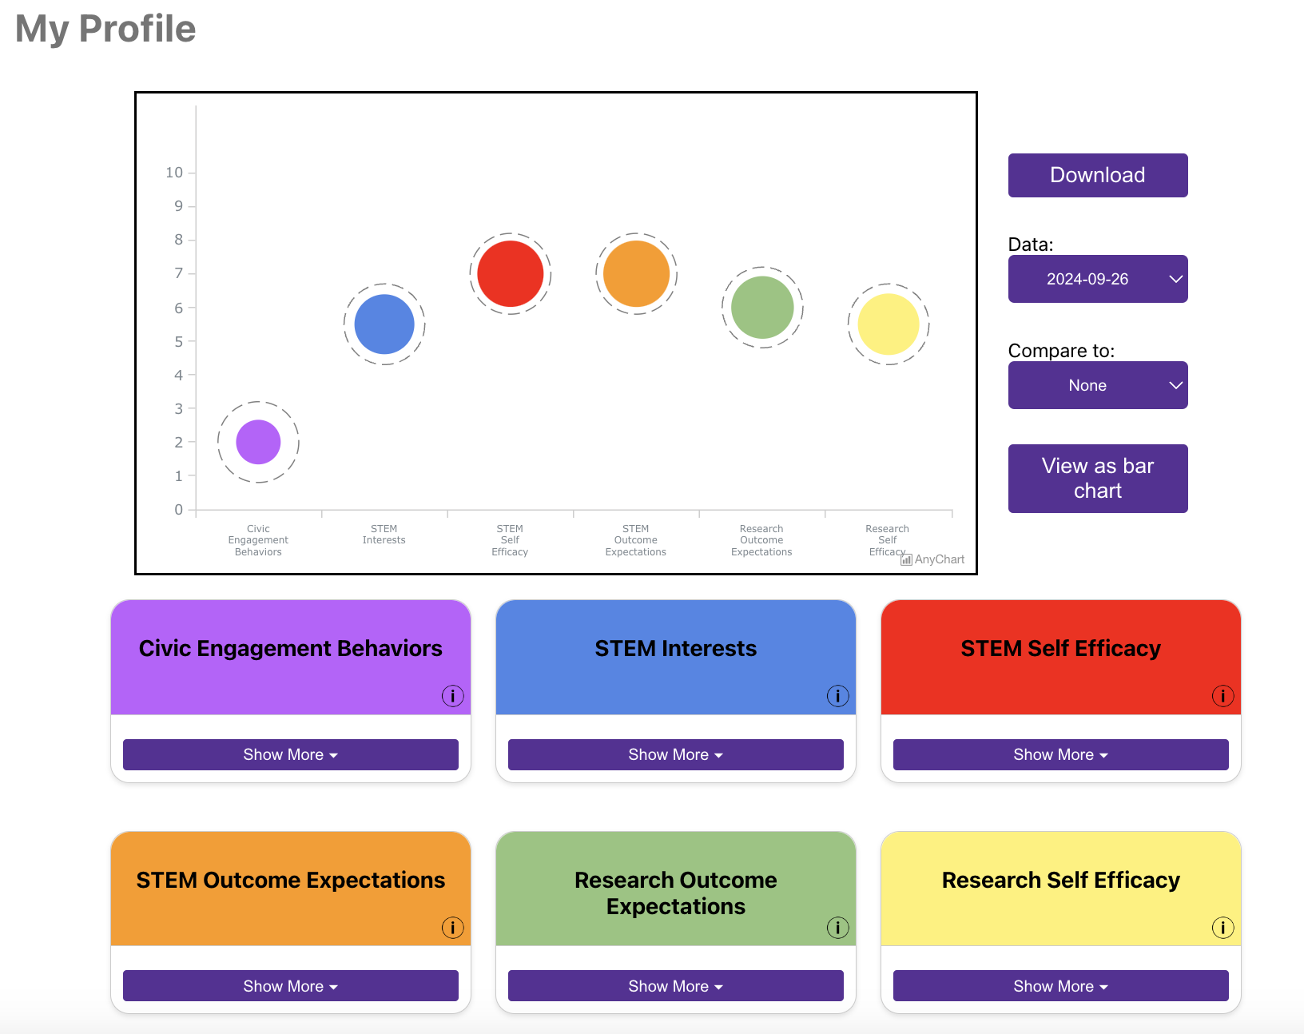
Student Functionality
Login through SSO or email
Take survey or view results
Use results to analyze strengths and weaknesses as a STEM student
Notes:
Isabelle
When students log in they will be able to either take the survey or view their results
Here is an example of a student's results. It shows a student's capabilities in 6 different areas so students can see what areas they need improvement in.
They can also view the results from surveys they previously took,
and they can compare old results to new results to see how they have grown or changed over the course of their time in the program

Slide 6
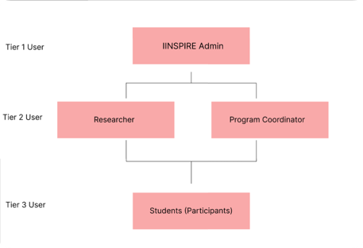
User Roles
Tier 1 User
IINSPIRE Admin
Tier 2 User
Researcher
Program Coordinator
Tier 3 User
Participants (Students)
Notes:
Landon
IINSPIRE Admin: Can create/edit surveys, invite/remove users, update/patch the app, allow data access/download.
Researcher: Can view/download survey results, submit request for new survey questions.
Program Coordinator: Everything that the Researcher can do but can create/edit/delete surveys.
STEM Students - sign-in/out, take assigned surveys, view survey results.

Slide 7
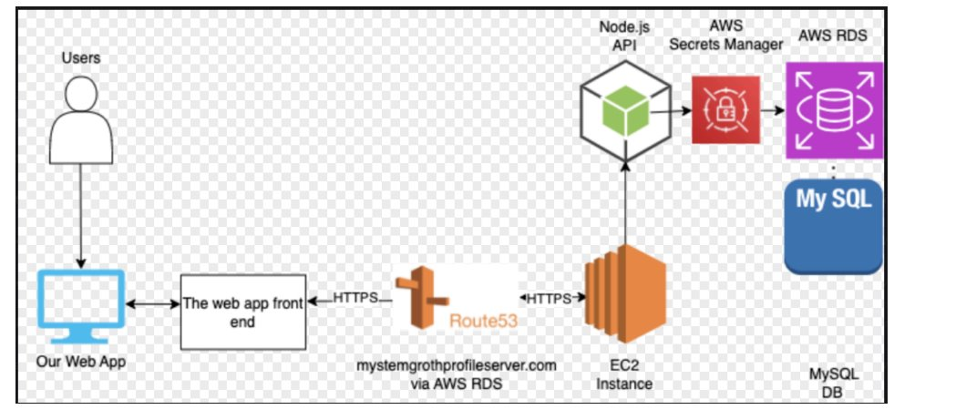
Technology Considerations
Developer Workflow: CI/CD through GitHub actions
Backend: Scalable infrastructure via ECS
Data Management: Prisma ORM for easy Db access
Security: SSL encryption via RDS and Next Auth for login
Old
New
Notes:
We made a major redesign of the previous projects architecture to make things smoother for both our end users and developers

Slide 8
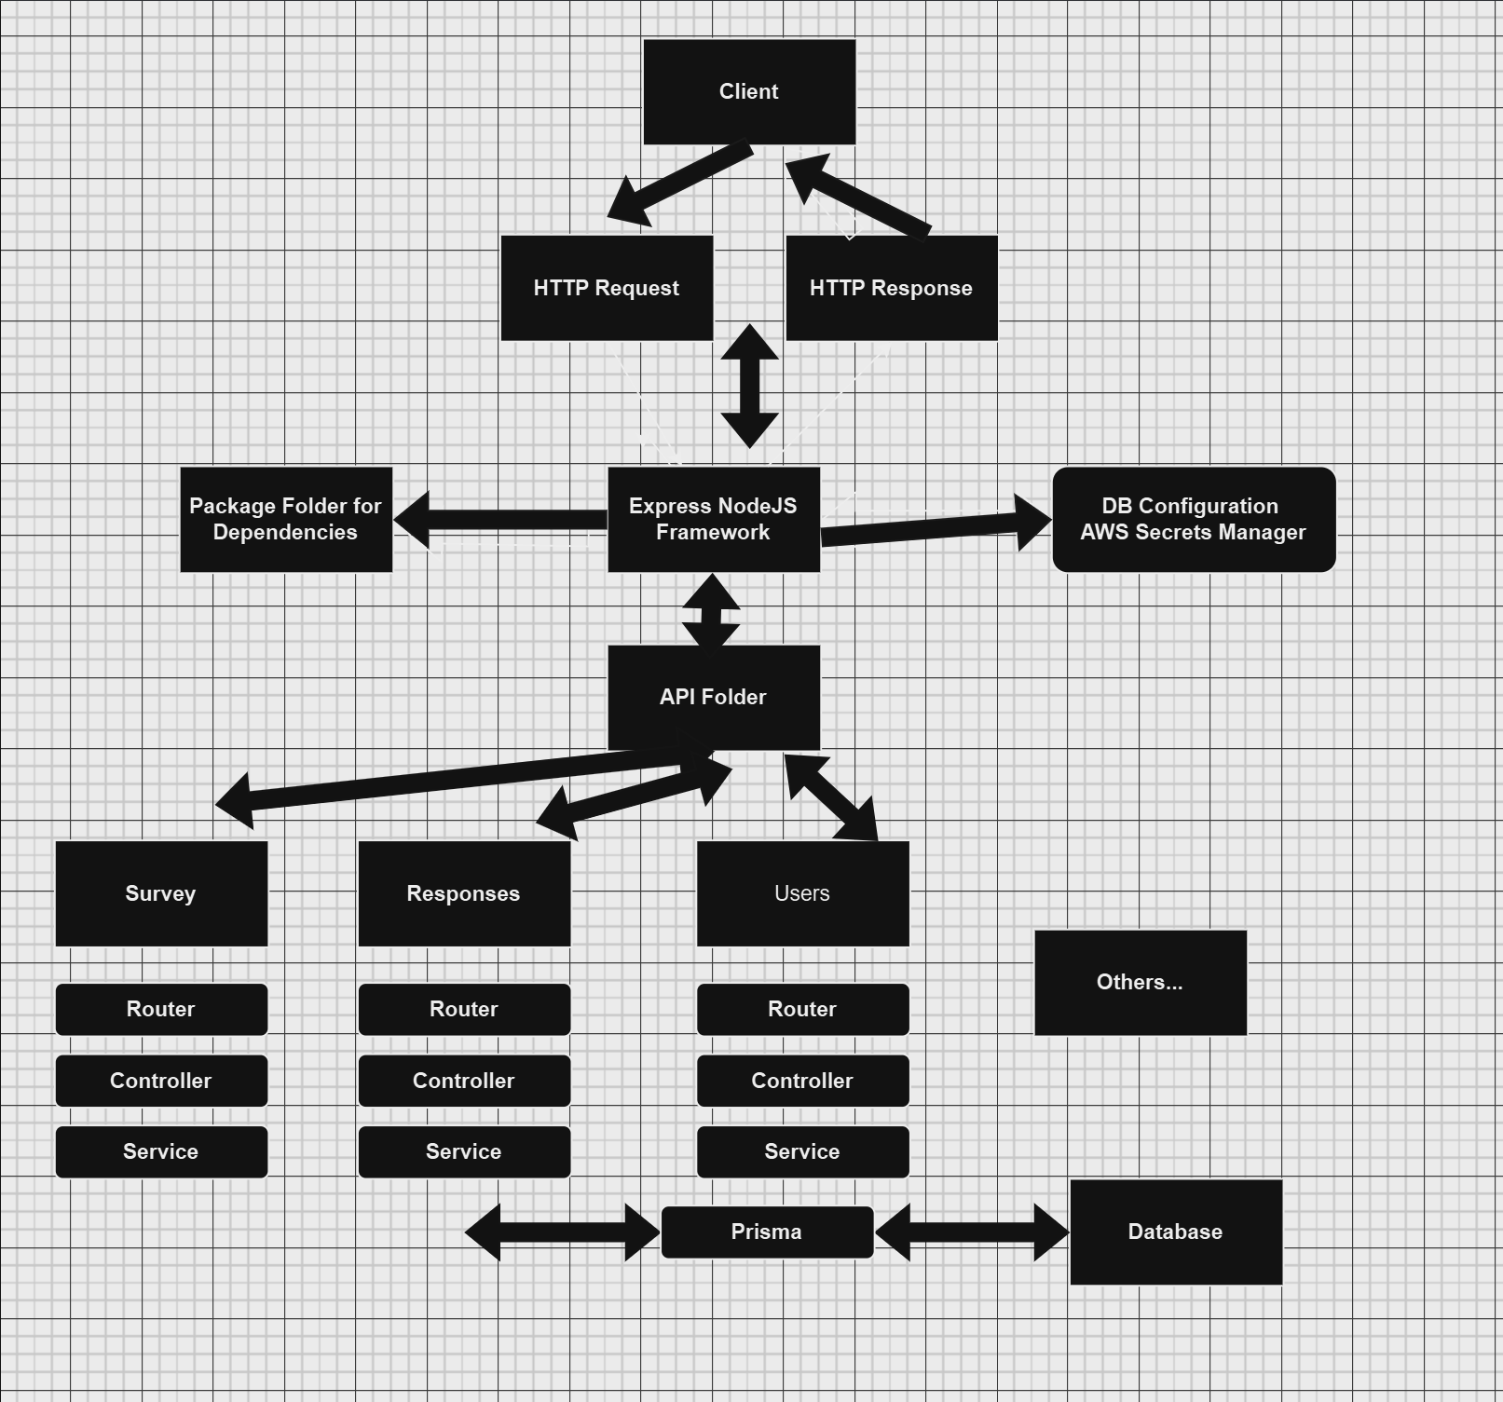
Technology Considerations Continued
On the right there is a High-level Backend Architecture Breakdown
API Gateway handles all requests and sends to appropriate router
Using a modular structure of API Components ex. Survey, Users
Allows for efficient code reuse, and quickly scaling new features.
Notes:
Charlie

Slide 9
Project Development Concerns
Meeting Requirements
Confident in enhancing previous team's system design
Already a working proof of concept from last year
Ensure Additional features are necessary to the client
Continuous development to improve frontend design
Must conduct User Experience interviews to gain feedback
Concerns
Agile Development Process creates a vulnerability to scope creep
Must set project milestone to explicitly define project scope
Notes:
Nick

Slide 10
Conclusion
Questions?
Notes:
Nick

