Slide 1
Contextualization/Design Check-In
Sdmay25-24
Dr. Diane Rover

Slide 2
Project Overview
Background:
The INSPIRE Survey gauges the research experience of undergraduates in STEM.
It is a survey visualization tool in the form of a web application.

Slide 3
Artifacts

Slide 4
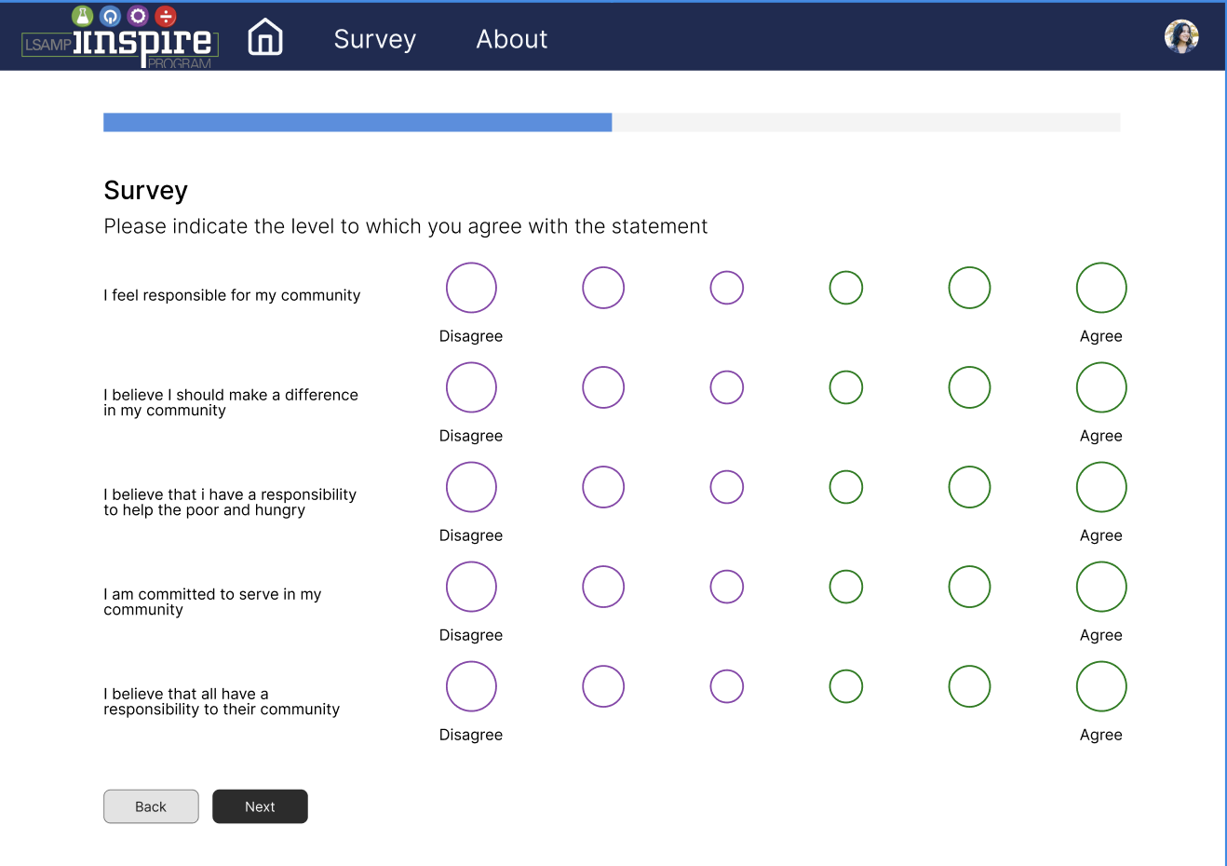
Human
The old app didn’t have a very good flow, especially when you were taking the survey (wrong input types, no progress bar, no back button). So our solution will address those issues and add more quality of life.

Slide 5
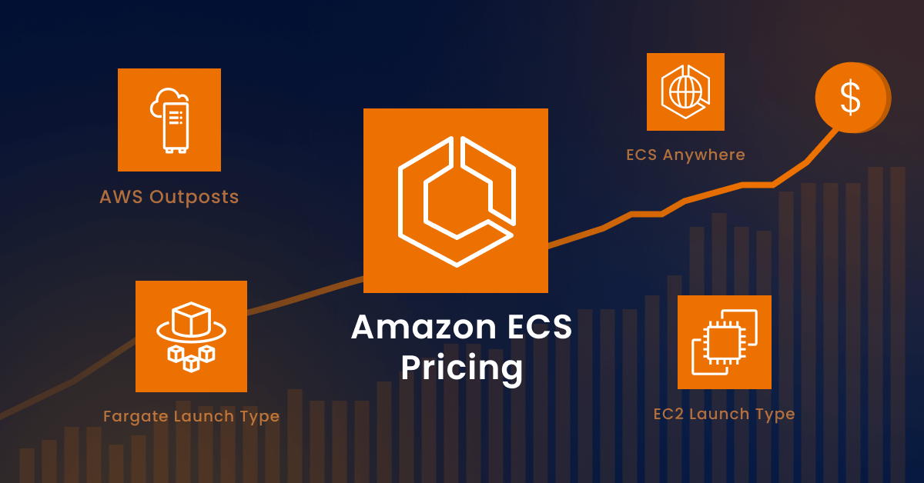
Economic
All changes have been made to try and reduce the complexity of our systems, but over the long term especially at scale the costs of managing and maintaining the EC2 will far outweigh the base cost of ECS.

Slide 6
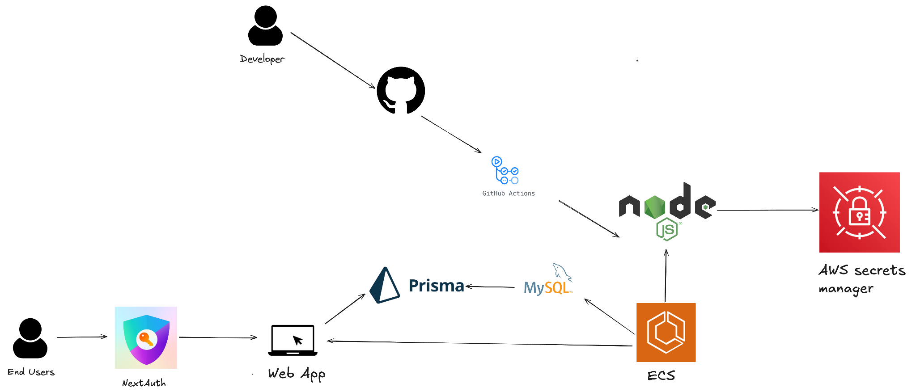
Technical
Cloud: ECS has been integrated to allow for automatic scaling of services
Backend: SSO integration, Prisma, and other security features
Frontend: Revamped Web and Mobile interfaces for users. Significant visual changes include layout, functionality, style, colors, etc.

