Slide 1
Lightning Talk 7: Prototyping
sdmay25-24

Slide 2
Project Overview
Background:
The INSPIRE Survey gauges the research experience of undergraduates in STEM.
It is a survey visualization tool in the form of a web application.

Slide 3
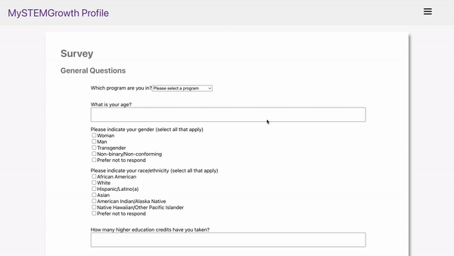
Prototypes
Demonstrate

Slide 4
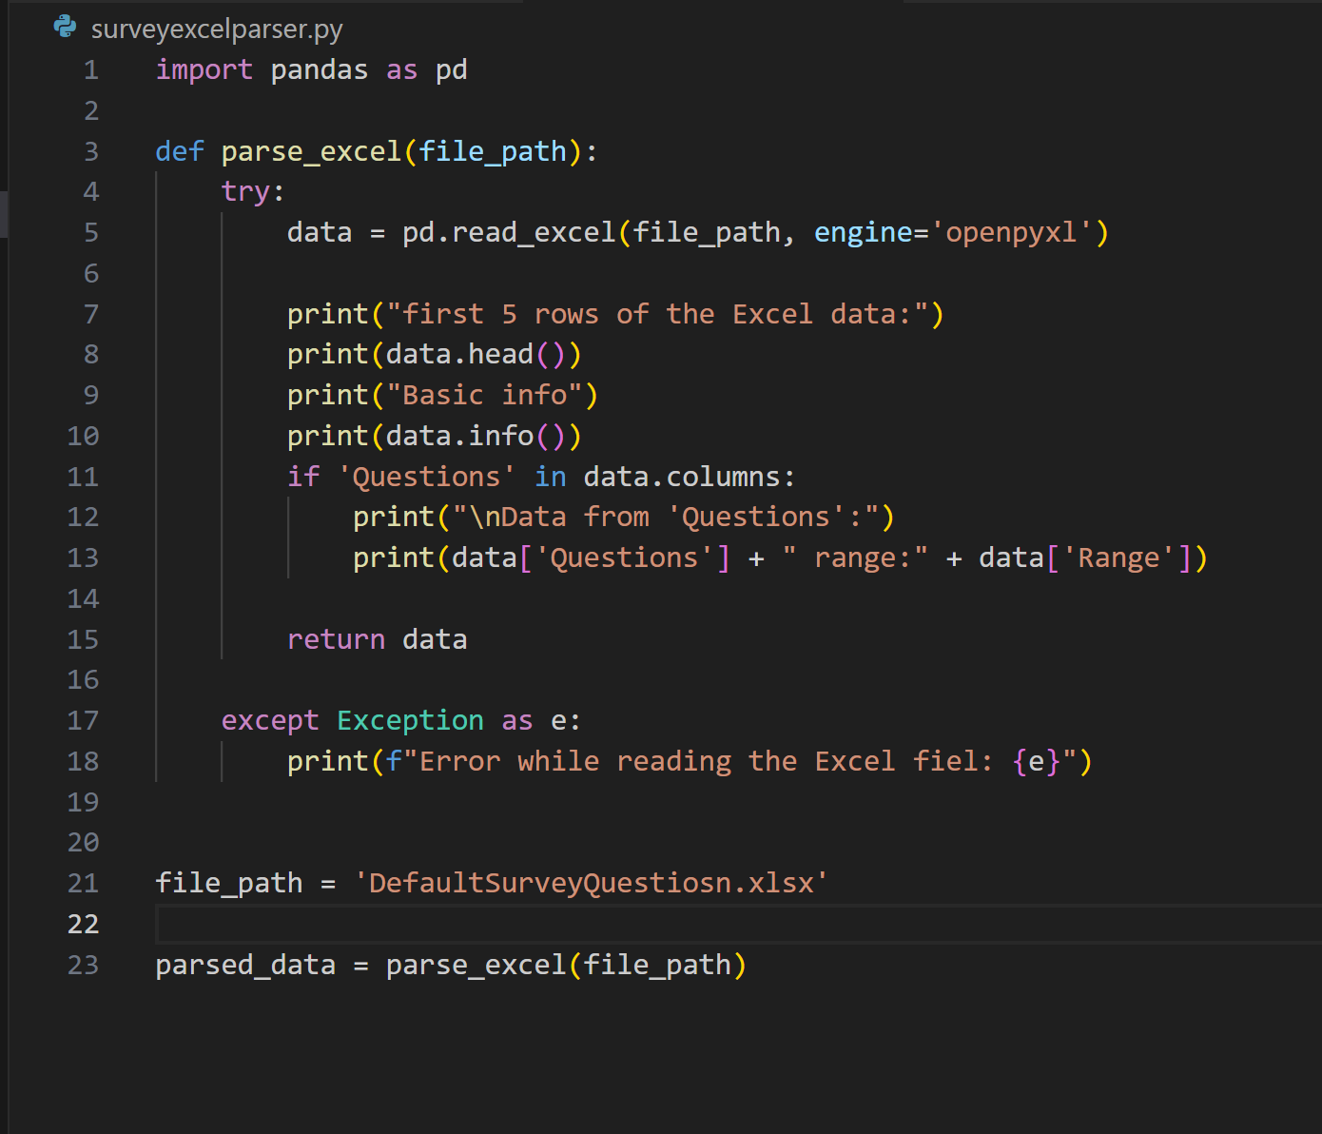
Prototypes
This was a prototype for the survey editing feature. We wanted to develop a barebones implementation for the survey edit feature. This python script is able to parse the excel sheet below. The python script will be able to parse over a newly uploaded sheet and import it to the database to be displayed on the User interface.
This prototype confirmed our confidence of this design working.

Slide 5
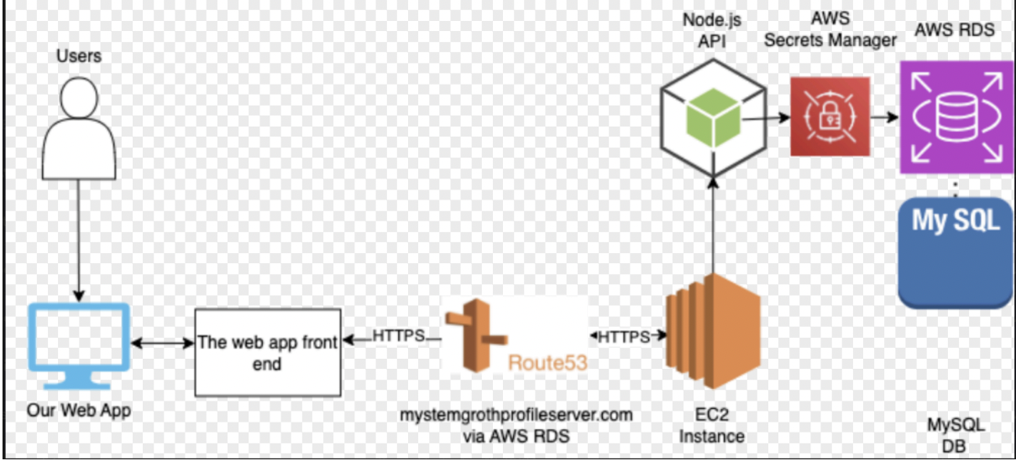
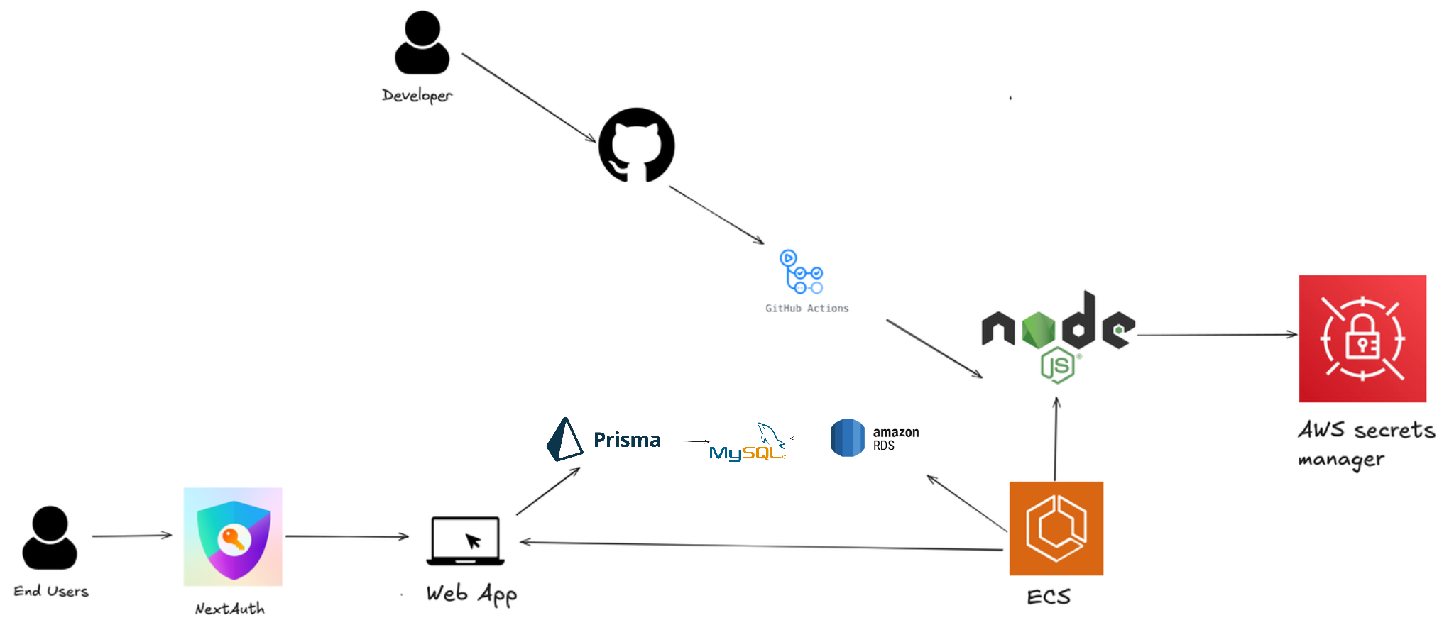
Initial Prototype Cloud Design
Final Cloud Design

Slide 6
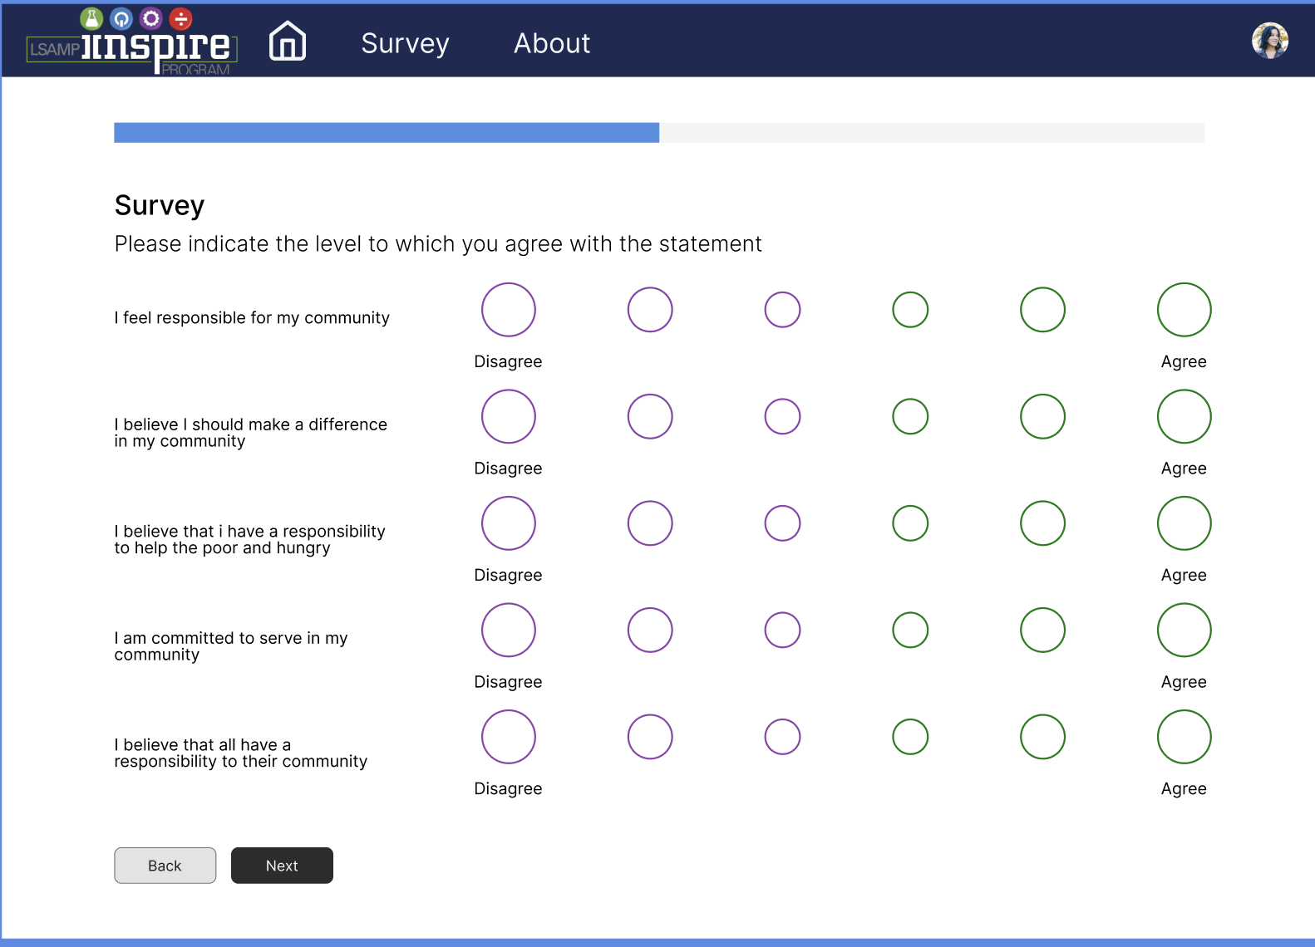
Reflection
New Prototype based on feedback:
From our meetings with an HCI contact and user focus group, the biggest takeaway was that we need to mitigate survey fatigue.
Solutions to do this:
need to chunk the questions based on question type or metric type
make the bubbles colorful to make scale more intuitive
have a save button so students can come back to the survey

Slide 7
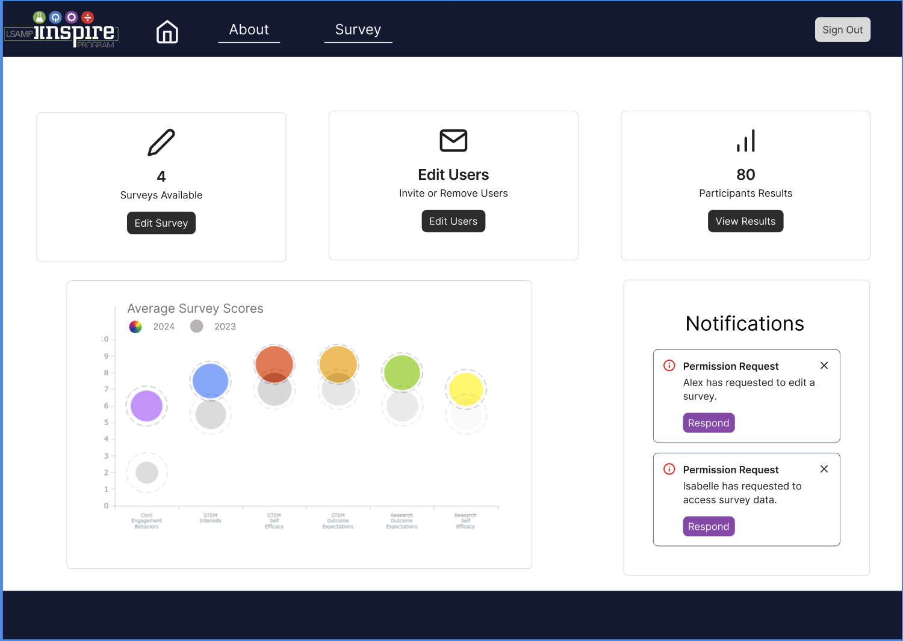
Next Steps
Upgraded UI
New Design Framework: Change from the previous UI to a responsive, mobile device friendly framework
Visual Consistency: Use different color schemes, images, and visuals to ensure users stay engaged.
Enhanced Functionality
Enhanced Survey Tools: Add support for various question types and other options for customized surveys depending on the user group.
Streamlined Navigation: Create role-specific dashboards with paths for survey actions, results access, and account management.

